Slide 1
以AI助力英語寫作教學創新：
基於POE平台的作文改進聊天機械人
Innovating English Writing Education with AI:
An Essay Improvement Chatbot on the POE Platform
Mr. KAN Ka Hei & Ms Chan Ho Yan
Lok Sin Tong Ku Chiu Man Secondary School

Slide 2
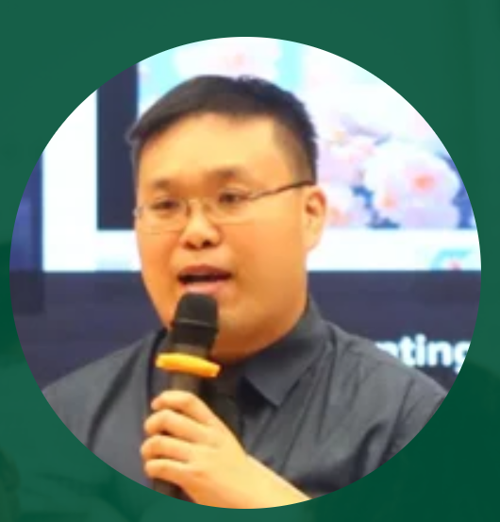

About Speaker
Mr KAN Ka Hei
Vice Principal, Lok Sin Tong Ku Chiu Man Secondary School
Former seconded Teacher, IT in Education Centre of Excellence (EDB)
Ms CHAN Ho Yan
English Panel Head, Lok Sin Tong Ku Chiu Man Secondary School

Slide 3
Presentation Overview
Brief introduction to the challenge in English writing education.
Introduction of the AI-powered Essay Improvement Chatbot on POE.
What you'll learn today:
  Chatbot Features & Demonstration
  Creating & Customizing Chatbots
  Prompt Adjustment Strategies
  Practical Application Cases

Slide 4
Bridging the Gap: Challenges in Writing Education
Common challenges faced by English writing students (e.g., grammar, coherence, vocabulary, ideation).
Challenges for educators (e.g., large class sizes, individualized feedback).
The rise of AI in education: opportunities for personalized and immediate feedback.

Slide 5
Bridging the Gap: Challenges in Writing Education
Feedback solution | Marking Accuracy | Timeliness | Feedback Quality | Cost | Accessibility
Teacher marking | ★★★★★ | ★ (Days) | ★★★★★ | ★ | ★★
POE Chatbot (by inputting text) | ★★ | ★★★★ (~30mins) | ★★★★ | ★★★★★ (POE Computing pt) | ★★★★★
POE Chatbot (by handwriting recognition) | ★ | ★★★★★ (~1mins) | ★★★★ | ★★★★★ (POE Computing pt) | ★★★★★
Solution Provided by Edu Tech Company | ★★★ | ★★★★★ | ★★★★ | ★★★ | ★★★

Slide 6
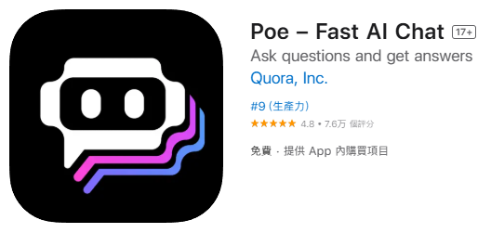

The POE Platform and Our AI Essay Chatbot
https://poe.com/
Available on web, Android & IOS platform

Slide 7

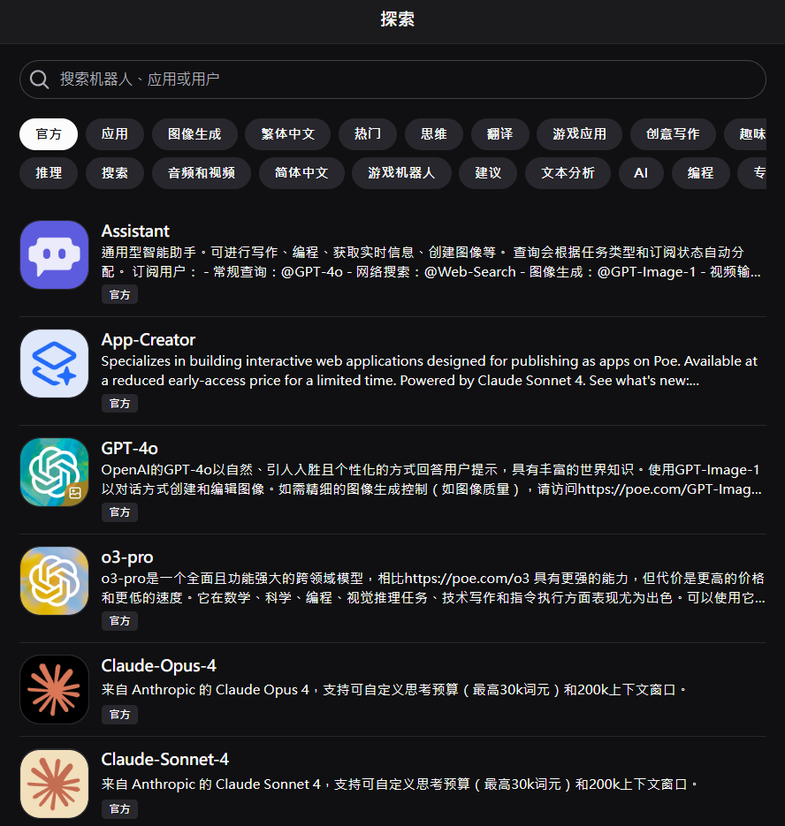
The POE Platform and Our AI Essay Chatbot
Numerous build in chatbot

Slide 8
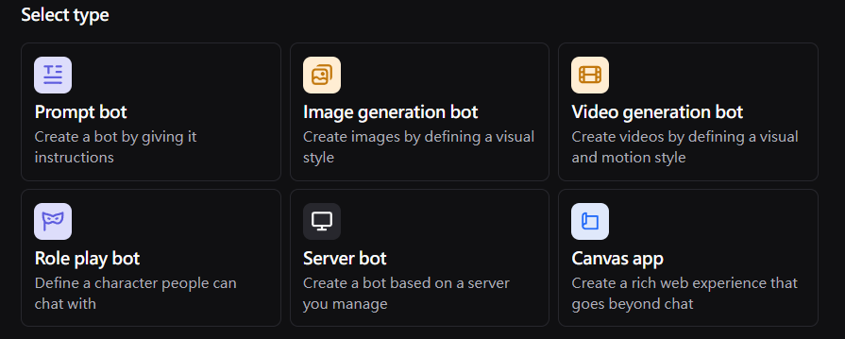
The POE Platform and Our AI Essay Chatbot
Users can customize a chatbot to meet their specific needs.

Slide 9
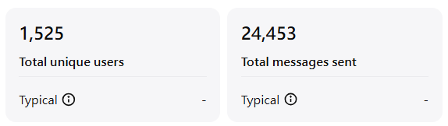
The POE Platform and Our AI Essay Chatbot
Chatbot I created before
You may search the chatbot
https://poe.com/kcmss ← Translation and grammar correction
https://poe.com/BHSSdictionary ← Vocabulary expansion
https://poe.com/KCM_IG_GPT ← Creating IG post

Slide 10
The POE Platform and Our AI Essay Chatbot
How to customize a chatbot ?
Base bot + Prompt + knowledge base (optional) + Greeting message (optional)

Slide 11

The POE Platform and Our AI Essay Chatbot
To maximize the accuracy of text recognition, a scanned version is used instead of taking a photo.
Demo: https://poe.com/s/9U0Ec4saaBCkyhgpWIpH

Slide 12
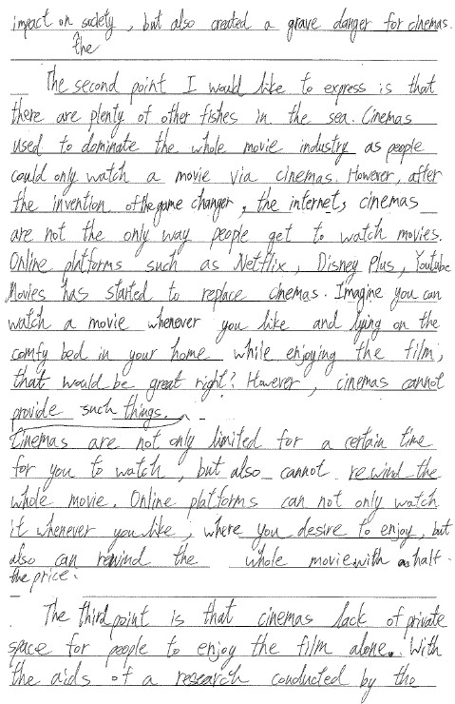
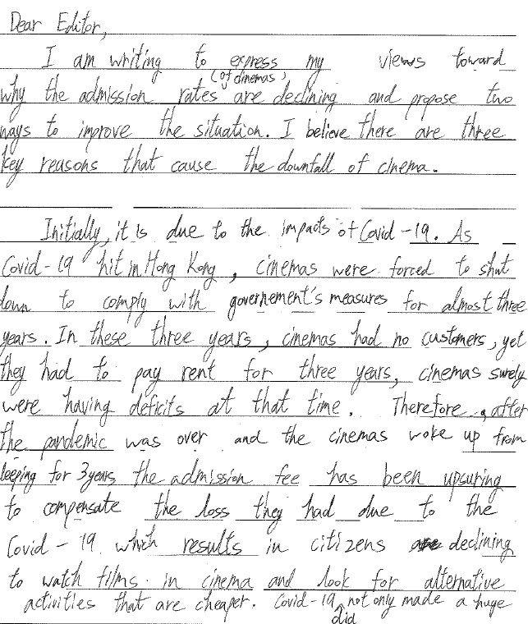

Slide 13
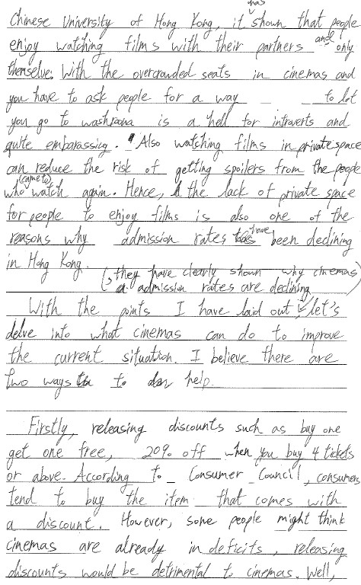
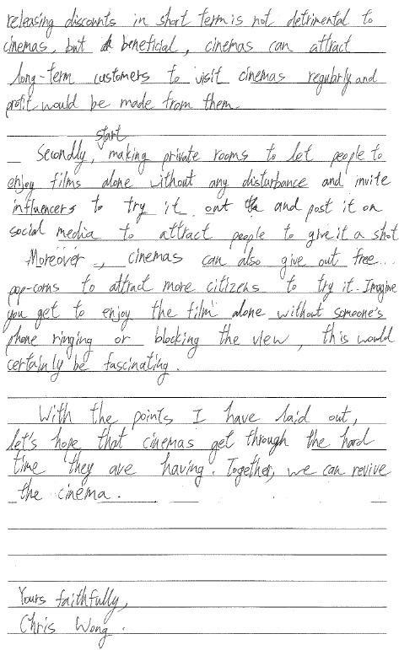

Slide 14
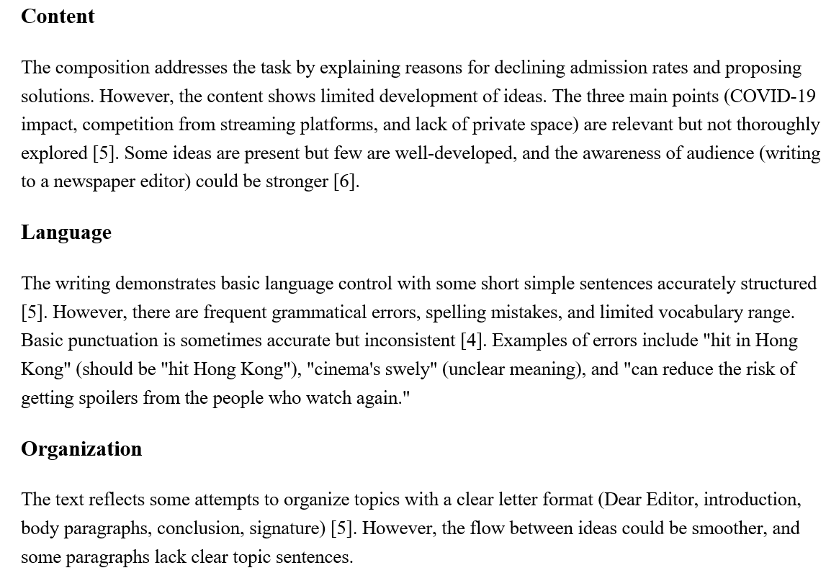

Slide 15
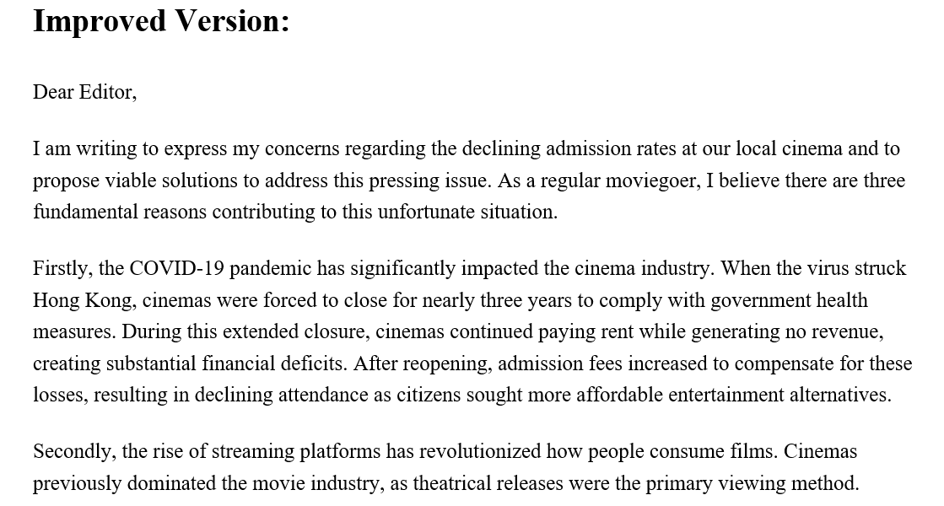

Slide 16
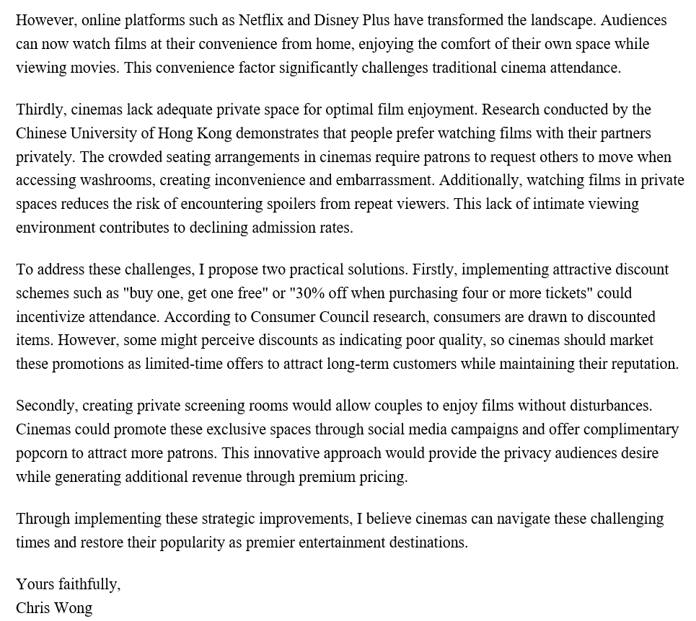

Slide 17
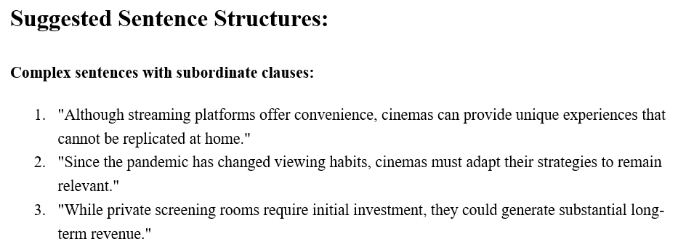

Slide 18
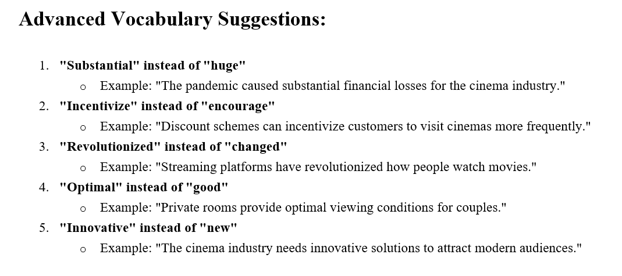

Slide 19

The POE Platform and Our AI Essay Chatbot
Base bot selection
The most advanced base bot requires a subscription to use.
In our AI Essay Chatbot, we used “Claude-Sonnet-4” as base bot. (Free to use, able to extract handwriting text from photo)
More advanced base bots require more computing points.
A free user receives 3000 points per day. It takes about 1200 points to provide feedback on an essay.

Slide 20
The POE Platform and Our AI Essay Chatbot
Prompt Engineering
Part 1: (Text extraction)
“If a series of pictures or photographs are uploaded, please extract the text from them first, following the order of the pictures.”

Slide 21
The POE Platform and Our AI Essay Chatbot
Prompt Engineering
Part 2:
As an English teacher, when I input an English composition,
  Please evaluate the composition according to the marking scheme I uploaded (MS.docx). Content (maximum score: 7), Language (maximum score: 7), Organization (maximum score: 7), and provide feedback for each domain. Provide feedback for each domain (Content, Language, and Organization); no score is required. ← negative prompt
  (An experiment was conducted, and the results show there is only a very weak correlation between Chatbot grading and teacher grading. Therefore, the scores are not worthy of display. However, the chatbot does provide some useful feedback based on the marking scheme uploaded.)

Slide 22
The POE Platform and Our AI Essay Chatbot
Prompt Engineering
Part 2: (How to feedback …)
Please rewrite the composition to show the student how it can be improved while maintaining the same meaning, point form is not allowed.← negative prompt
Please suggest a sentence structure to the student and provide at least three examples that may be useful for their learning.
Please suggest five advanced vocabularies to the student and provide at least one example each that may replace their simple vocabularies in their work.

Slide 23
The POE Platform and Our AI Essay Chatbot
Prompt Engineering
Part 3: (Writing question)
  Here is the question: “ To avoid the copyright issue, the actual question is not provided in this PowerPoint”

Slide 24
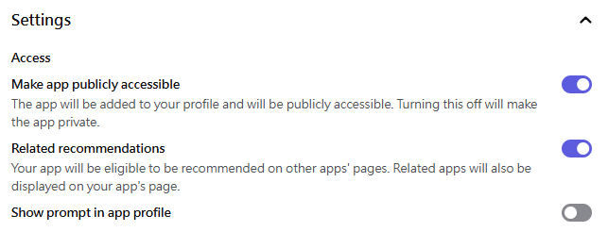
The POE Platform and Our AI Essay Chatbot
Share the AI essay chatbot to the student

Slide 25
Practical Application Cases
Based on the POE platform
Integrated into the teaching practice to enhance students' writing skills and self-directed learning

Slide 26
AI Marking – Strengths and Limitations
Provides immediate marking and feedback
Marking is not always fully accurate
AI scores and comments as reference only
Maintains teachers’ professional judgment
Encourages students’ critical thinking

Slide 27
Value of Improved Essay Versions
Generates enhanced essay drafts
Shows richer vocabulary and complex sentence structures
Provides clear organization examples
Supports self-directed learning through comparison
Encourages reflection and active writing improvement

Slide 28
Advanced Language Support
Generates complex sentences/phrases tailored to context
Offers at least 5 advanced vocabulary items
Beneficial for HKDSE English Paper 2 preparation
Promotes vocabulary expansion and syntactic variety
Helps internalize effective writing techniques

Slide 29
Pedagogical Benefits & Summary
Supports differentiated instruction with customizable prompts
Complements traditional teaching methods
Frees teachers for targeted guidance
Promotes autonomous learning and critical reflection
Enhances writing proficiency for high-stakes exams

Slide 30

Technology cannot ever replace great teaching.
But it can make great teachers even better.

